Slide 1



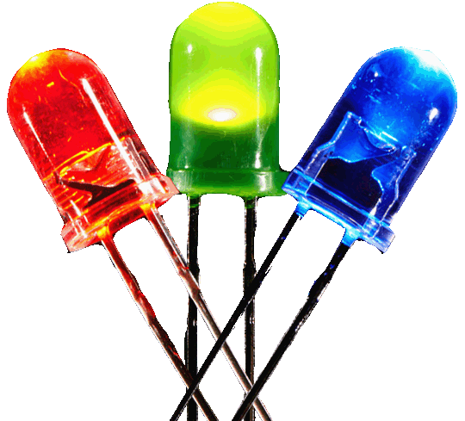
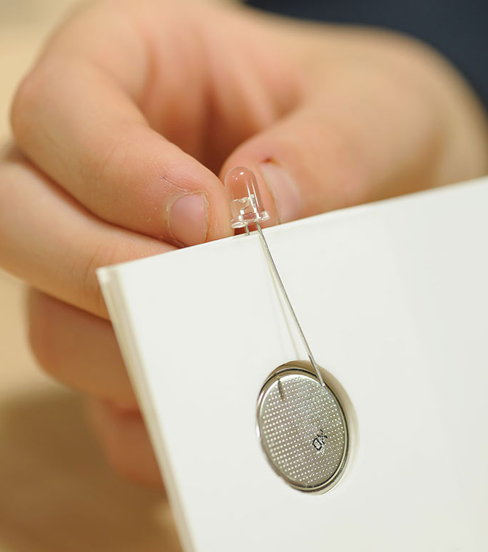

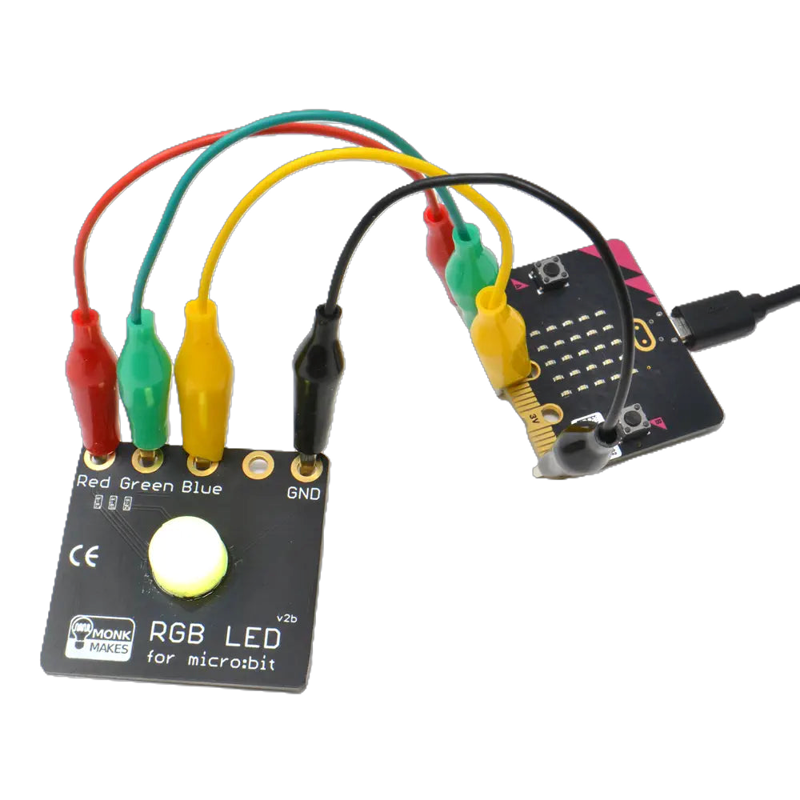


Programme Outline
Stage 1: In-school 1-hour workshop delivered by EESW.
An introduction to what an LED is and how it works followed by a hands-on additive colour mixing task.
Stage 2: Fully resourced teacher led micro:bit coding task.
Pupils are tasked with controlling the red, green and blue channels to produce any colour of light.
Resources for this stage will remain with the school, allowing this task to repeated and embedded into the curriculum.
Who is the programme aimed at?
This programme is designed for pupils in Key Stage 3, or those working towards Progression Step 4. Each workshop can accommodate up to 30 pupils, but EESW can offer multiple sessions to allow a whole year group to take part.
What does the school need to provide?
Stage 1: Facilitate the delivery of the in-school workshop. All resources will be provided, and the session will be led by EESW team members. A member of school staff must be present to supervise pupils in each workshop and is encouraged to engage with the session.
Stage 2: Using EESW teacher guides, including video tutorials and handouts, teachers are required to deliver a follow up coding workshop. Pupils will require a laptop or similar device to access makecode.microbit.org. All resources are gifted to the school.
Feedback: Teachers and pupils that engage with the programme will be asked to complete a short on-line feedback questionnaire used to evidence both participation, engagement and the impact of the programme to our funding partners.

Slide 2


Costs and Availability
The workshop and resource kits are provided free of charge thanks to funding from CSconnected Sparking STEM Futures Programme within the Cardiff Capital Region.
The programme is available between May 2025 and November 2026. The teacher-led activities should be scheduled as soon as possible after the EESW led workshop. To qualify for full funding, feedback surveys must be completed within 30 days of the Stage 1 workshops.
We can deliver multiple workshops, each for up to 30 pupils, allowing us to engage with a whole year group. Funding is limited and allocated on a first-come-first-served basis across each of the local authority areas which make up the Cardiff Capital Region.
Colour Coders and the Curriculum for Wales
Ambitious, capable learners
Pupils build understanding of circuits, LEDs, and colour mixing through hands-on tasks, then apply this knowledge in coding by adjusting RGB values. This develops problem-solving, logical thinking, and the ability to apply learning across science and technology.
Enterprising, creative contributors
Learners experiment with combining colours and coding different effects, encouraging creativity, innovation, and resilience through testing and refining their ideas.
Ethical, informed citizens
By exploring how LED screens work, pupils gain awareness of everyday digital technologies and their wider role, including energy efficiency and responsible use.
Healthy, confident individuals
Practical success in lighting LEDs and coding builds confidence. Collaborative activities support communication, teamwork, and a positive learning experience.
Overall impact
Colour Coders links practical science with coding to show how real-world technologies work, supporting all four purposes of the Curriculum for Wales.

Slide 3
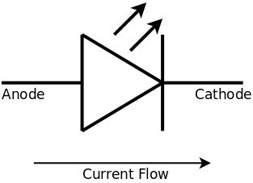

Alignment with Progression Steps 3 - 4
Designing thinking (Computing & digital competence)
Learners progress from: Controlling LEDs using simple code and experimenting with RGB values (PS3)
to: Developing structured, efficient programs using variables, loops, and refinement (PS4)
Overall: Builds computational thinking from basic control to designing and optimising digital systems
Design and engineering
Learners progress from: Making and testing simple LED systems (PS3)
to: Refining, evaluating, and justifying designs with consideration of constraints (PS4)
Overall: Evolves from creating to evaluating and improving solutions
Science and technology in society
Learners progress from: Recognising how LED screens work in everyday devices (PS3)
to: Analysing their applications, efficiency, and impact (PS4)
Overall: Builds from awareness to informed, critical understanding
Electricity and energy systems
Learners progress from: Building simple circuits and observing how LEDs light (PS3)
to: Explaining and predicting circuit behaviour, including current, voltage, and brightness control (PS4)
Overall: Moves from hands-on exploration to secure conceptual understanding
Light and colour
Learners progress from: Exploring additive colour mixing using red, green, and blue LEDs (PS3)
to: Controlling light intensity precisely and explaining how digital displays create colour (PS4)
Overall: Develops from observation to accurate control and explanation

