Slide 1
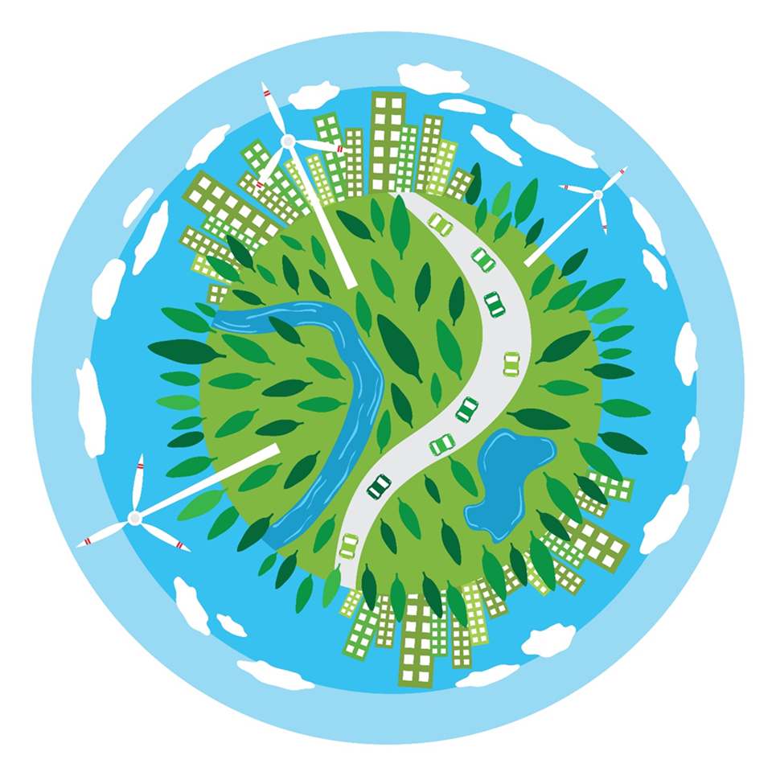
My Sustainable Community Competition
Celebrating 150 years of The Institution of Engineering and Technology

Slide 2
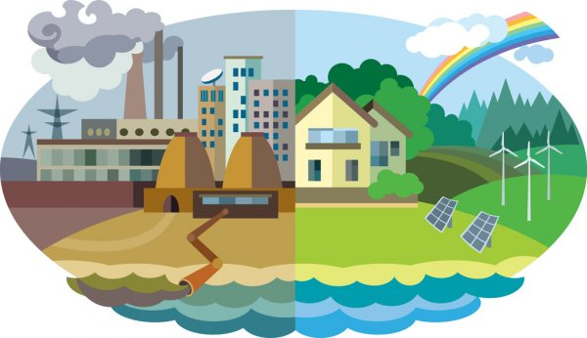
How are humans impacting our planet?
Humans impact the physical environment in many ways: overpopulation, pollution, burning fossil fuels, and deforestation. Changes like these have caused many problems to our planet, such as climate change, soil erosion, poor air quality, and undrinkable water.

Slide 3
What is sustainability all about?
Sustainability is the idea that humans must interact with the environment in a way that ensures we stop harming our planet and allows for enough resources left for future generations.

Slide 4
What exactly are Earth’s resources and how can engineers help?
The Earth's natural resources include air, water, soil, minerals, plants, and animals.
UNESCO defines sustainable engineering as the process of using resources in a way that does not compromise the environment or deplete what is available for future generations. Sustainable engineering requires an interdisciplinary approach in all aspects of engineering, and it should not be designated as a sole responsibility of environmental engineering. All engineering fields should incorporate sustainability into their practice in order to improve the quality of life for all.

Slide 5
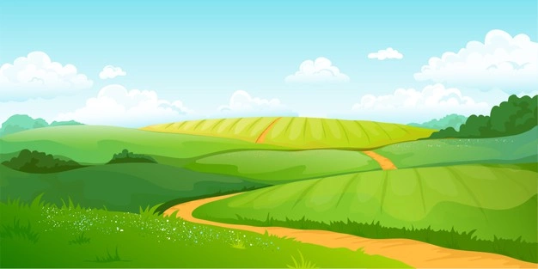
Your MY SUSTAINABLE COMMUNITY challenge:
You are required to design and build a sustainable community, similar to the community you live. Imagine an open piece of land with nothing on it, a blank canvas, this is where you begin!
Your community needs 150 homes to accommodate the residents, the rest is up to you!

Slide 6
Things to consider in your community:
Water
Heating
Food
Economy
Transportation
Services
Health and wellbeing

Slide 7
Wondering where to start…
Do some research into your local community and consider other communities around the globe. Can you find any problems in your community you would like to address or areas to improve to make it more sustainable?
Establish a timeframe for tasks to make sure you use your time efficiently. You have calendars in your handbooks to help you, or you could create a Gantt chart with your teacher.
Start to brainstorm ideas and research possible solutions to help make your community more sustainable.
Consider possible solutions.
Preparing initial designs, record all sketches, design ideas and models to show progression of ideas.
Develop your designs to a finished concept.
Produce any display or digital models to represent the community/specific part of the community.

Slide 8
Competition Portfolio/Booklet/Poster & Model(s)
Competition Class | Individual: | Small Groups (2-10): | Large Group (+10):
1 Age 7-10 | A project booklet/poster, plus a small community model or individual model of part of the community. | A project booklet, plus a completed community model or several individual models of different areas of the community. | A class project booklet, plus a completed community model or several individual models of different areas of the community.
2 Age 11-14 | A portfolio/booklet/poster, plus a small community model or individual model of part of the community. | A portfolio (suggested length of 14 pages), plus a completed community model or several individual models of different areas of the community. | A class portfolio (suggested length of 15+ pages), plus a completed community model or several individual models of different areas of the community.

Slide 9
Portfolio/Booklet guide
1. Title Page :
Name of school, project title, each student’s and team name and class year - design a professional cover.
2. Contents:
Indexed list of contents in the project with page numbers – if there are sub sections include these.
3. Overview:
Essential details of the project, such as a statement of the project, the main results, and conclusions
4. Introduction:
Project brief and background information.
5. Research and analysis:
The background to the project, with details of research, to assist the investigation. Develop possible solutions to the challenge and any decision analysis – e.g., what are the advantages and disadvantages.
6. Procedure:
A description of processes leading to the selection of the best solution. How were ideas generated, what system did they involve for decision making and consistency, how did they rank the solutions they have developed?
7. Design:
An illustrated account of the process of arriving at the final solution. From initial sketches to the final design.
8. Conclusion:
A statement of solutions to the challenges faced. Include strengths and weaknesses, benefits and opportunities and areas still to develop.

Slide 10
Useful resources & videos exploring sustainability

Slide 11
Energy
https://www.youtube.com/watch?v=RnvCbquYeIM

Slide 12
Farming
https://www.youtube.com/watch?v=xFqecEtdGZ0&t=70s

Slide 13
Water
https://www.youtube.com/watch?v=OCzYdNSJF-k&t=3s

Slide 14
Engineering Council’s 6 Guidelines to Sustainable Engineering
This guidance is intended as an introduction to sustainable development and aims to encourage all those working in engineering to adopt sustainability thinking in their practice.
Helpful links are available on the Engineering Council’s sustainability website pages: www.engc.org.uk/sustainability

Slide 15
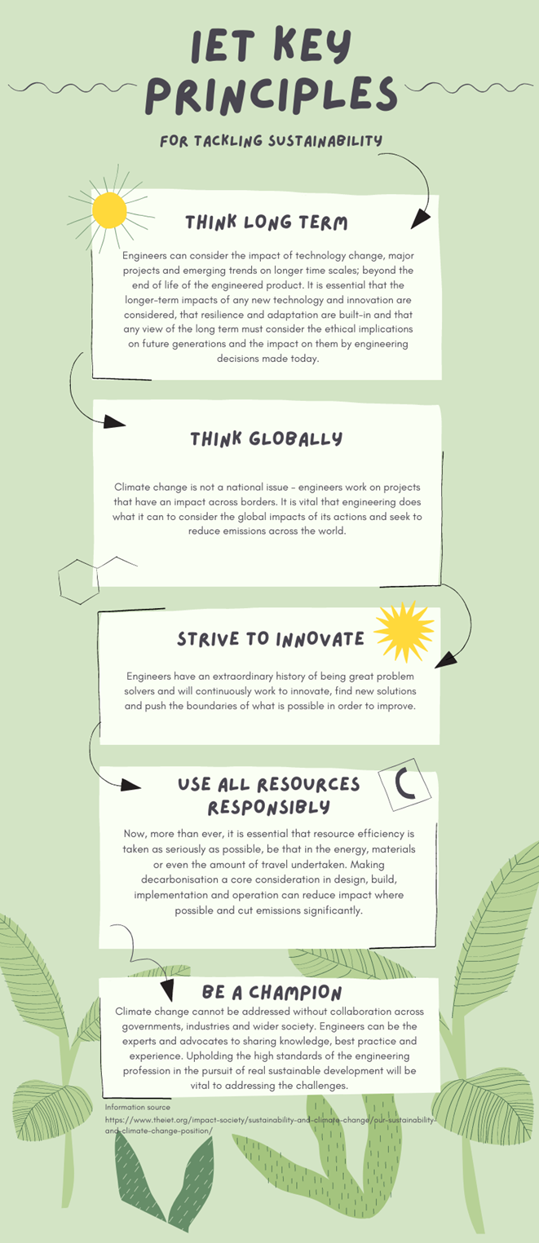
IET Key Principles
Engineers have the skills, insights and ingenuity to help tackle climate change in ways that optimise efficiency, economy, safety and reliability. As engineers, we are problem solvers and innovators, with a unique world perspective. Most of these issues are significant, challenging and require unprecedented collaborative action. Engineering is central to solving them.
Lots of helpful resources can be found on the IET website to help you understand the current issues around tackling sustainability: www.theiet.org/impact-society/sustainability-and-climate-change/

Slide 16
Good luck! We can’t wait to see the communities you create.

