Slide 1
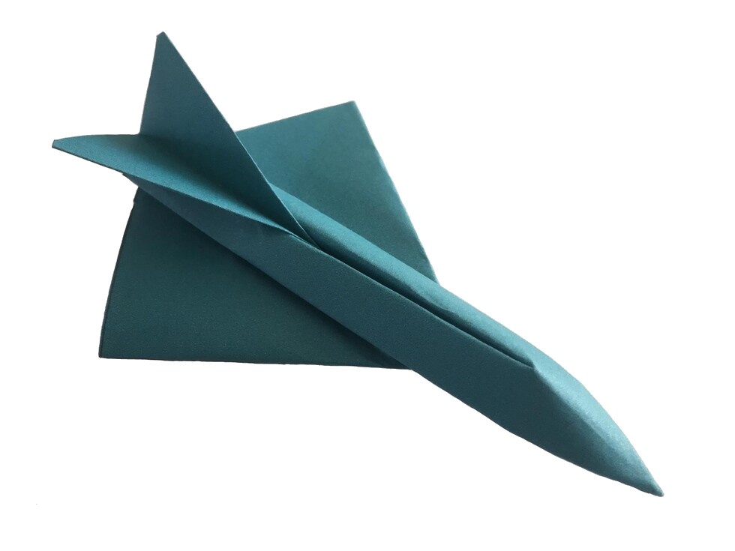
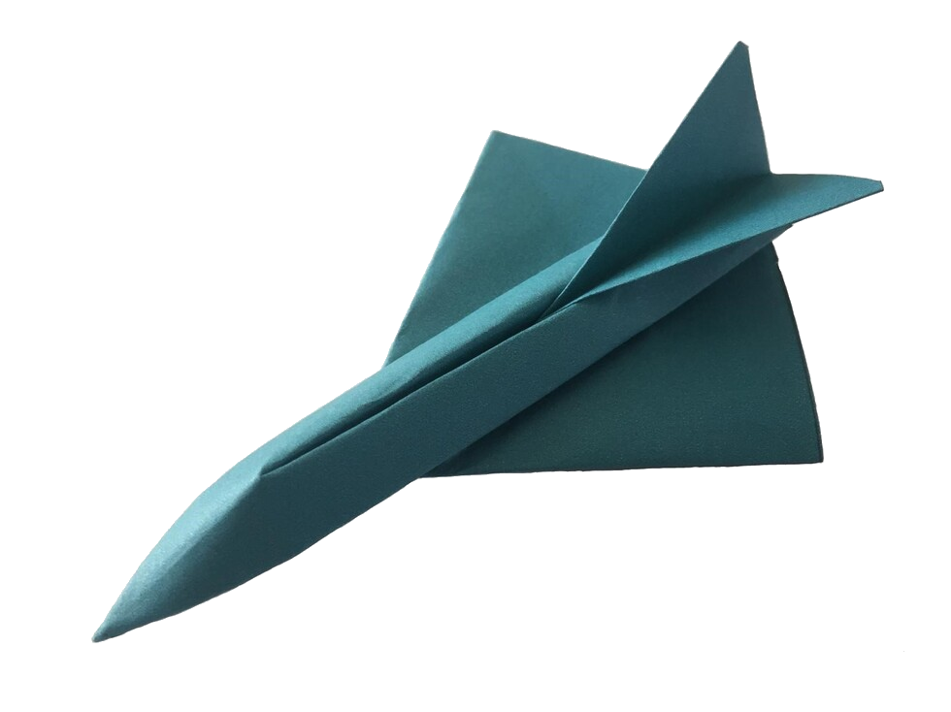
Small Planes
Learn about how planes fly, prove a theory, create your own Small Planes and use them to collect data, estimate, calculate and record your own results…
See how far your Small Plane can fly…!

Slide 2
How Planes Fly…
Thrust must be greater than drag
Lift must be greater than weight

Slide 3
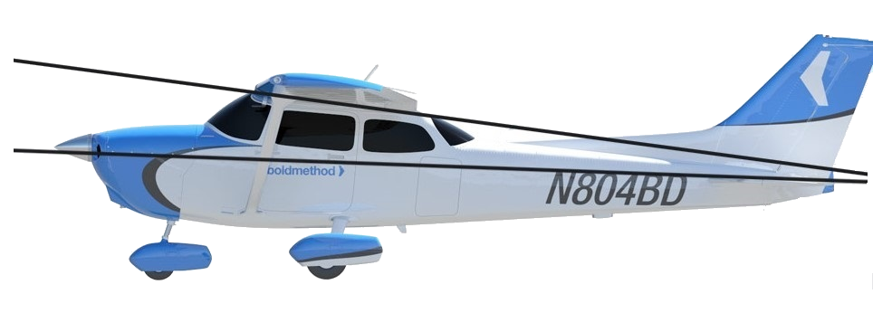
Lift is generated in 2 ways… 1. Wing angle 2. Wing profile (or shape)

Slide 4
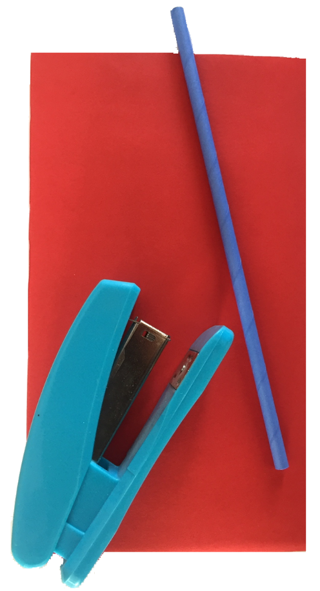
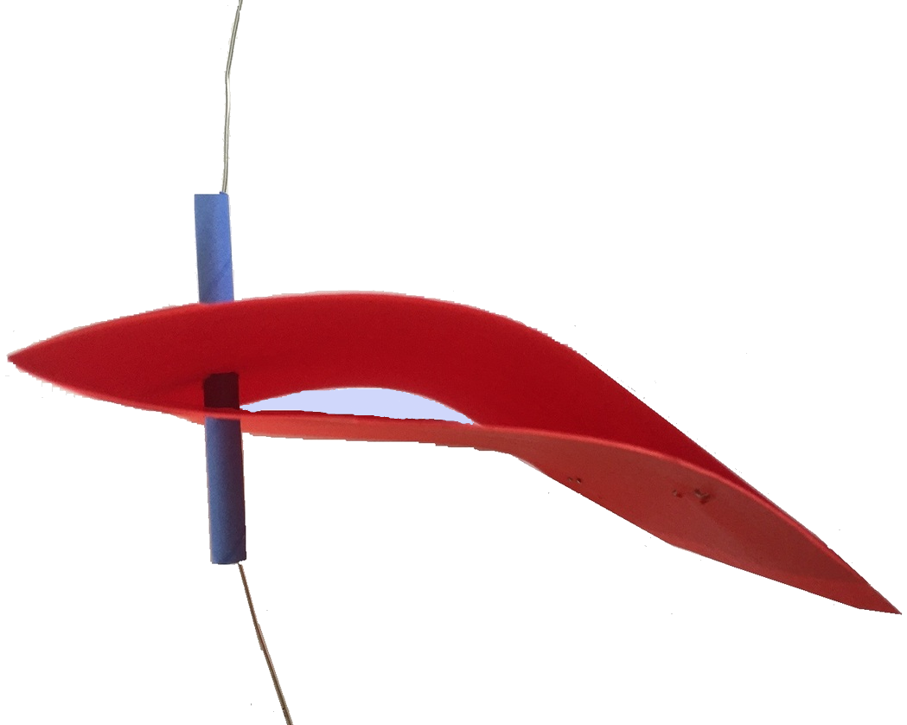
Let’s prove wings do work…
You will need: Thick paper, paper straw, stapler, string or wire and a desk fan
Fold the paper in half.
To create the wing shape staple the top edge 5mm before the bottom edge
Make a hole near the front of the wing and feed a short length of straw through
Feed string or wire through the straw

Slide 5
Let’s prove wings do work…
Please take a look at the first video – ‘Prove the theory of flight’ https://www.stemcymru.org.uk/home/activities/online-teaching-resources/small-planes/
Watch the video clip and use your own wing to prove the theory of flight…

Slide 6
Let’s make a Small Plane…!
Please take a look at the second video – ‘Plane build part 1’ https://www.stemcymru.org.uk/home/activities/online-teaching-resources/small-planes/
Remember: Name or decorate your plane so you can identify it during testing

Slide 7
Almost there!
Please take a look at the third video – ‘Plane build part 2’ https://www.stemcymru.org.uk/home/activities/online-teaching-resources/small-planes/
Remember: Name or decorate your plane so you can identify it during testing

Slide 8
Preparing to fly…
Please take a look at the fourth video – ‘Creating our wing reference sheet’ https://www.stemcymru.org.uk/home/activities/online-teaching-resources/small-planes/

Slide 9
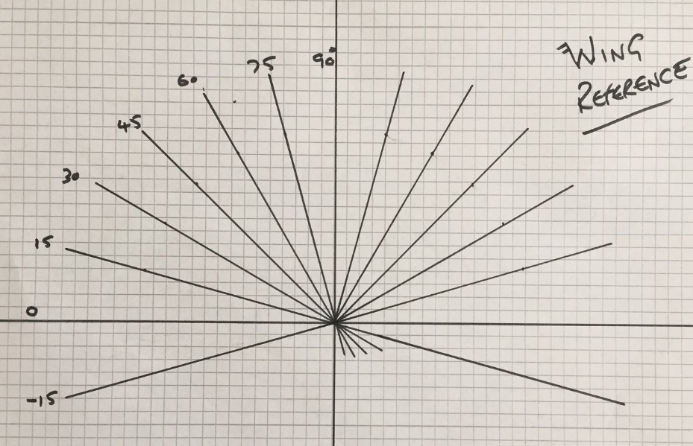
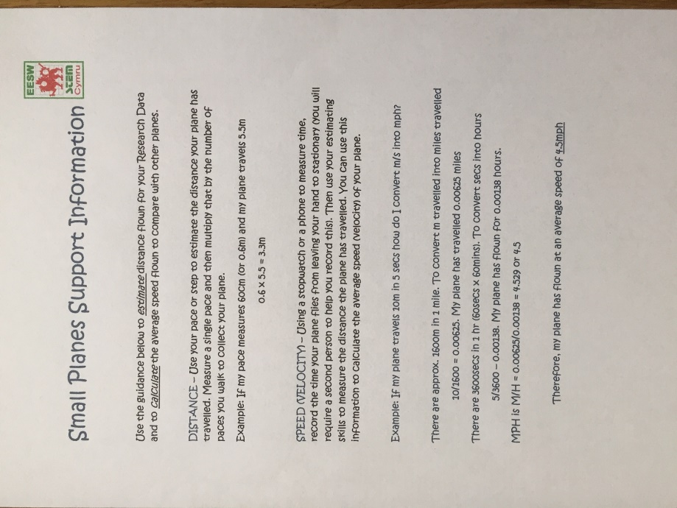
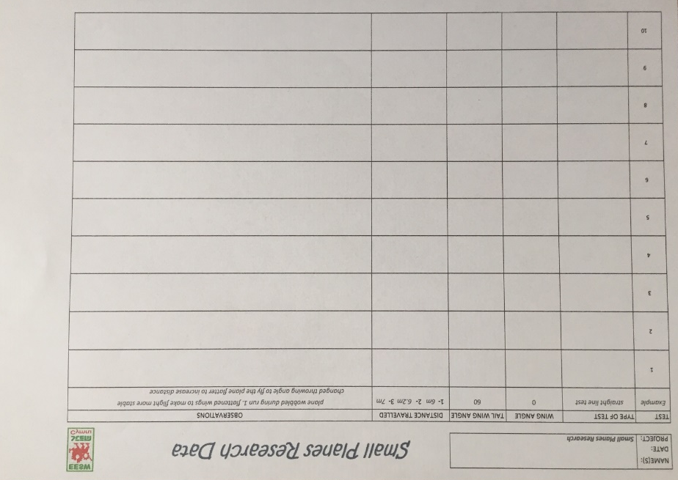
Small Planes Flight Procedure
Now using your wing reference sheet and support information
provided, complete your research by flying your Small Plane and filling out the data sheet
Once you have completed your research you are ready for your challenges
Can you land your plane on the A3 runway provided?
Can you bank your plane left and right?
Can you make your plane dip and then lift?
Whose plane flies highest?
Whose plane flies furthest?
Whose plane has the highest average speed?

Slide 10
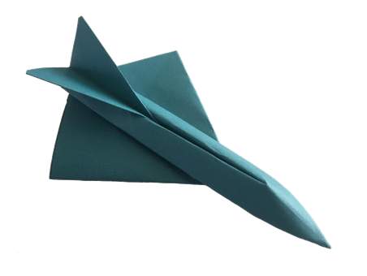
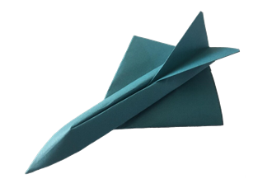
A BIG CONGRATULATIONS on completing the Small Planes Challenge
You have learnt how planes fly, made a model wing, used it to prove the theory of flight, followed instructions to build your own small plane, estimated and collected data, calculated and recorded results
Now your final challenge is to write up a short report.
Include the challenges (how planes fly? Proving a theory and building a small plane).
How you collected your data and recorded your results
Did your small plane complete all the challenges?
Finally, include any changes you would make for further improvements

