Slide 1
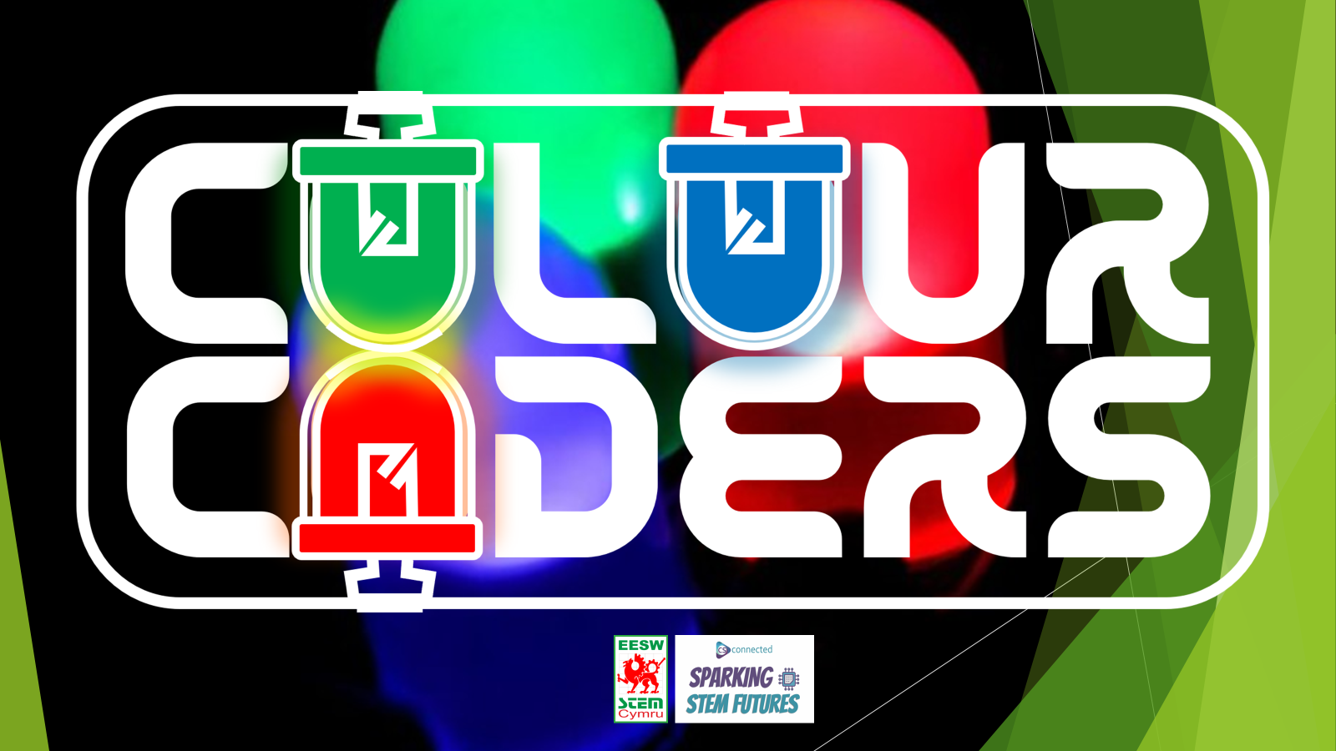
Teacher Coding Guide
Notes:
General introduction- names, who we work for, what we do- 1 min

Slide 2

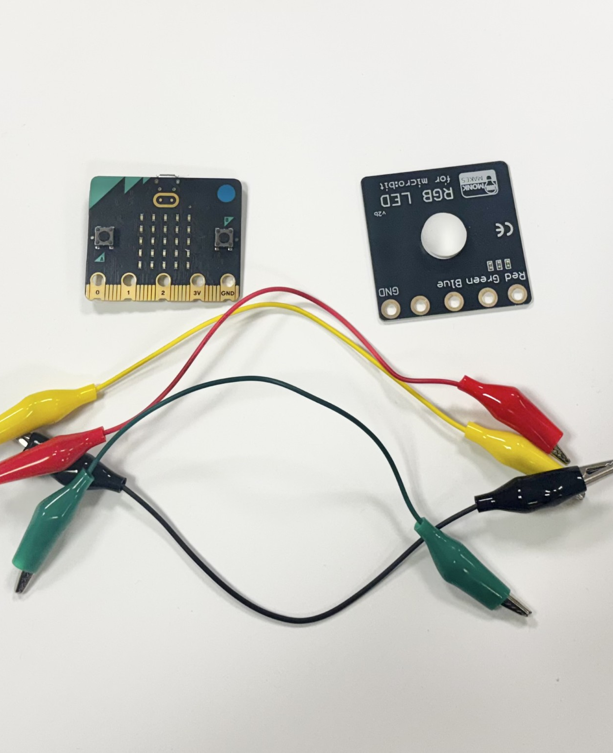

You will need:
A micro:bit
RGB LED for micro:bit
4 Crocodile clip wires (any colours)
A device with access to MakeCode – the free to access block coding platform designed for micro:bit

Slide 3
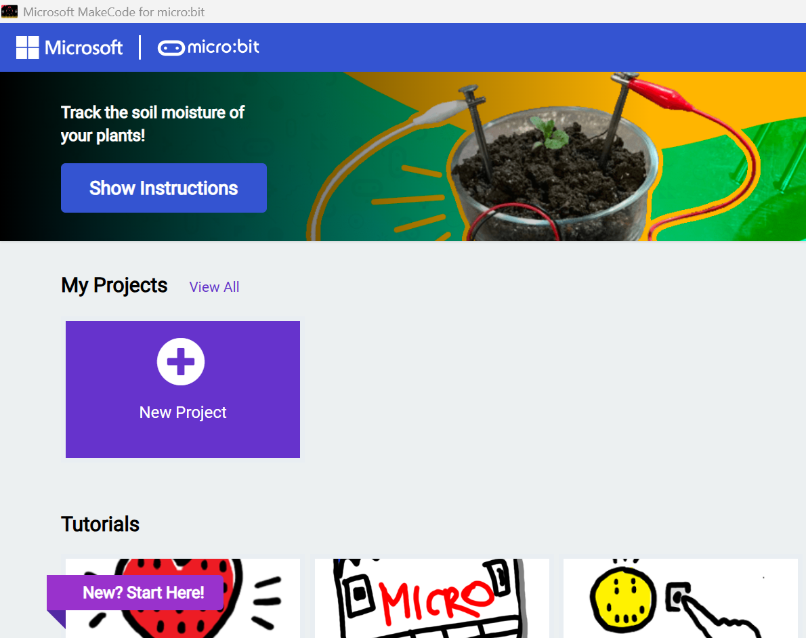
Accessing MakeCode
As this is designed as a coding task for pupils with little to no coding experience it is expected that pupils will use the block coding options though for more advanced pupils there are options available that use Python.
You have can access MakeCode in a variety of ways depending on which type of device you want to use and whether or not you will have internet access.
Online with a desktop/laptop/Chromebook with a USB port – access via your browser and www.makecode.microbit.org
Offline with a desktop/laptop/Chromebook with a USB port – download the MakeCode app Offline | micro:bit
Using an iPad or Android tablet - Mobile apps | micro:bit – your kit only includes a USBA to USB mini cable, if you do not have a suitable cable port on your device or if a suitable cable is not available for the device port you can also transfer your code via Bluetooth.

Slide 4
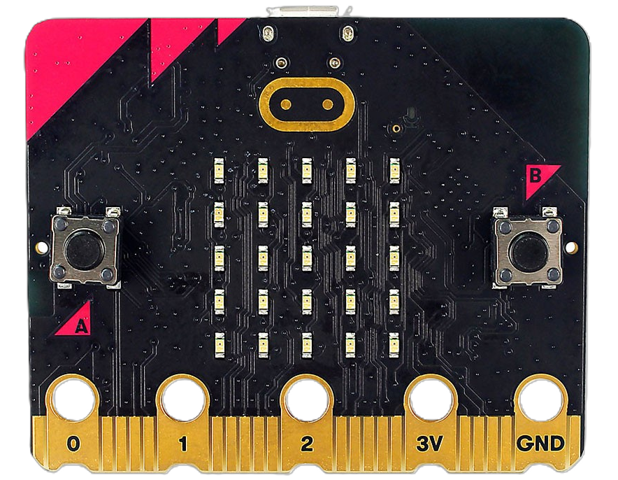
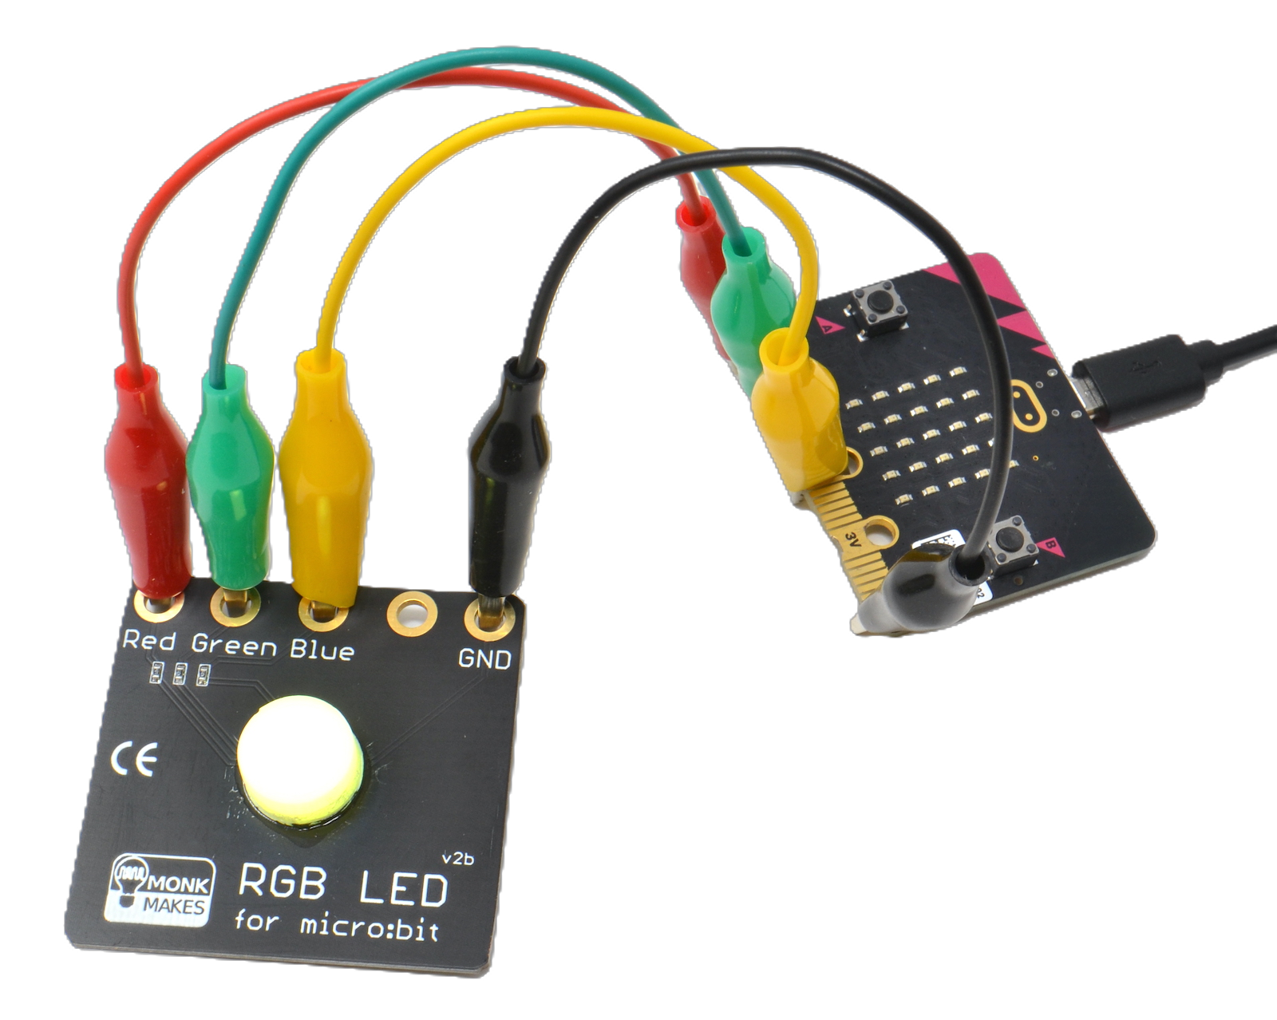
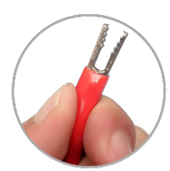
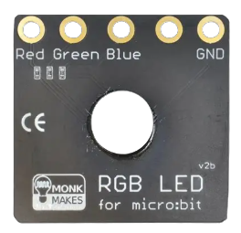
Step 1
Connect your wires
The crocodile clip wires are used to connect corresponding ports on the RGB LED board and the micro:bit.
It doesn’t matter which colour wires are used.
The microUSB plugs into the back of the micro:bit it provides a power and data link to your device when plugged in
Squeeze to open
Notes:
Insert pic of this here

Slide 5
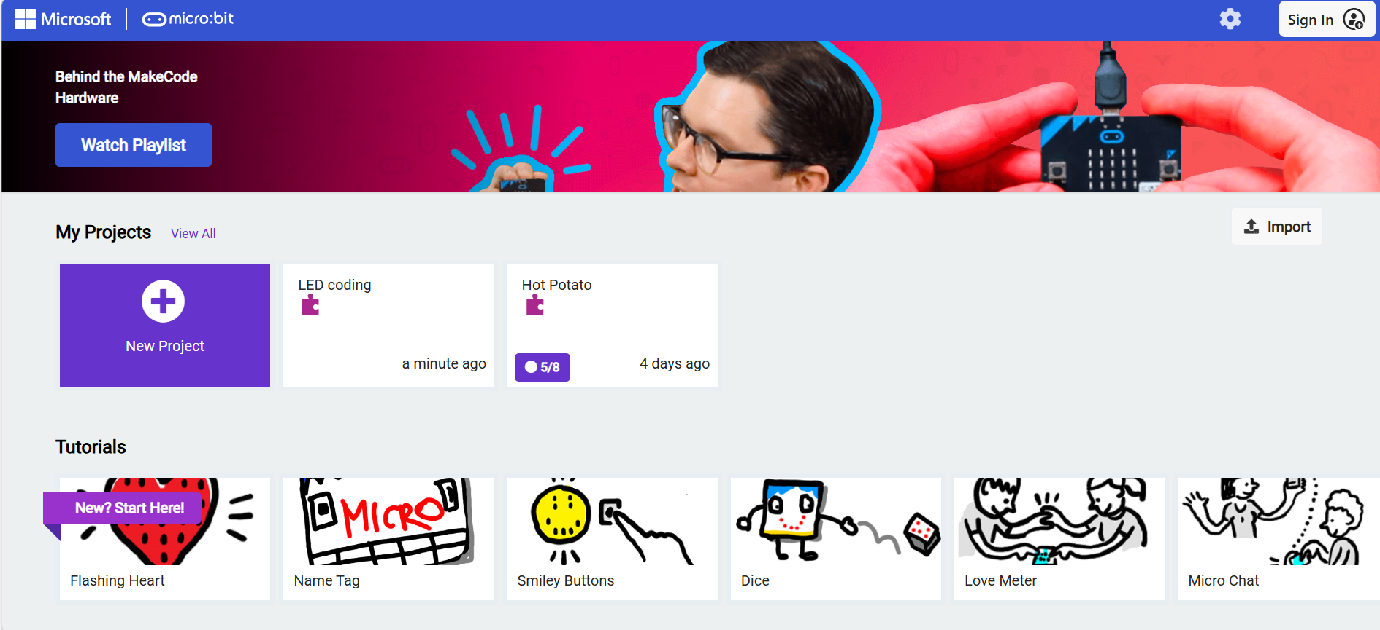
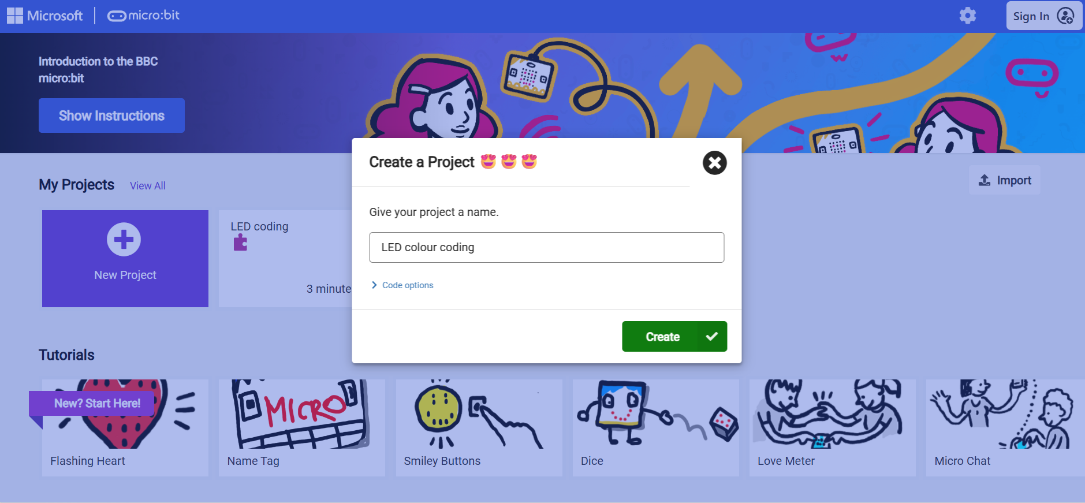
Step 2
Let’s code
Access Microsoft MakeCode
Click on new project and name it ‘LED colour coding’, this will open a new project screen.

Slide 6
MakeCode Basics
Please now watch “CC Video Pt1”

Slide 7
Building the Code
Please now watch “CC Video Pt2”
Why do we use 1023?
We use an analogue pin as they can read a range of voltages (Digital pins can only read 0 or 1), typically between 0V and 3.3V for micro:bit but microcontrollers, like the one inside a micro:bit can’t process a continuous voltage they need to convert it into a number. This is done by and ADC – Analog-to-Digital Conversion.
Micro:bit uses a 10-bit ADC, 2¹⁰ = 1024 different values ranging from 0 to 1023

Slide 8
Coding the Primary Colours – Red, Green & Blue
Please now watch “CC Video Pt3”
Duplicate
Select the block/locks you want to duplicate and right click on the mouse to duplicate, if using a Chromebook, tap two fingers on the track pad at the same time to bring up the duplicate option. Ctrl + C to copy and Ctrl + V to paste will also do this.

Slide 9
Transferring the Code to the Micro:bit
Please now watch “CC Video Pt4”
Using a tablet or mobile device?
Using iOS app on iPad Transfer programs from MakeCode to your micro:bit on an iPad or iPhone – YouTube
Using the Android app Transferring programs from MakeCode to your micro:bit using the Android app - YouTube

Slide 10
Coding the Secondary Colours – Magenta, Cyan & Yellow
Please now watch “CC Video Pt5”

